Slide 1
Capstone Project The Battle of Neighborhoods
Selecting the best location to open an Pizza shop IN Manhattan, New York

Slide 2
Introduction/Business Problem
For this project, we have a client that is interested in establishing a pizza shop somewhere in New York. He wants to find an optimal spot where he can find customers and where there are not too many pizza shops around.
His last shop didnt do to well because there were many pizza shops around the block and not too many people would visit.
The issue here is the New York City is known for its restaurant and finding an optimal place will be difficult. This analysis will use clustering to find an optimal location

Slide 3
Data Selection
For this analysis we will be using two sources to get our data:
NYU: (https://geo.nyu.edu/catalog/nyu_2451_34572)
Foursquare
NYU has a json file that contains the 5 boroughs and the neighborhoods that exist in each borough as well as the the latitude and logitude coordinates of each neighborhood.
We will use foursquare's api to determine the location of pizza shops in the given boroughs

Slide 4
Methodology
Once the data is collected and put into pandas dataframe I will:
Clean the data
Only take a subset of the borough's, ie. Manhattan
Visualize the rows we have on a map
Do some summary statistics, counts

Slide 5
Methodology
We also need to use Foursquare's data to get the venues:
Collect data
Visualize venues on a map
Run statistics to see counts of venues categories
Even though we only care about pizza as a category, other categories might pop up

Slide 6
Methodology
Machine Learning Algorithm:
The machine learning algorithm I am running is a KMeans clustering. I have decided to use 5 as the number of clusters. From there, each data point will be assigned a given cluster.
I am using this algorithm because I want to determine where is an optimal location to place the pizza shops. The location where there is the least amount of cluster will be the best place.

Slide 7
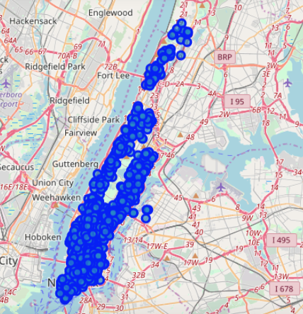
Methodology
Pizza Shops in Manhattan

Slide 8
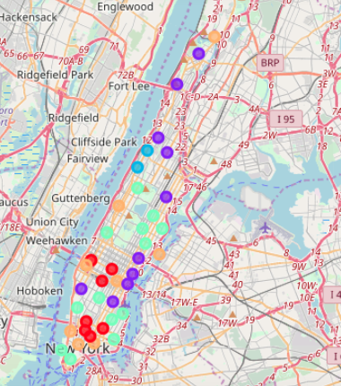
Results
Based on dataframe analysis above Cluster 3 (Upper West Side ) and Cluster 2 (Morningside Heights) areas are the best places to open a new pizza shop.

Slide 9
Discussion
If I had more time for this project, I would find an optimal value for k, instead of just picking k = 5.
Five Clusters could be an optimal one but I would have ran some tests to see if it was the best one.
Something to note that is mentioned in the code:
When visualizing the venues on a map, it appears that 1667 is to many points
However, when I took a sample of 1500 I was able to see that on a map.
Something to note is that the data is performed on a limited amount of data

Slide 10
Conclusion
After we ran the machine learning algorithm, we were able to determine which location is optimal to set up a pizza shop. There is some room for improvement, either in the collection of more data or tunning the parameter k and seeing which is the best k.

